Slide 1
Single-Point Urban Interchanges
David Baker, P.E.
Staff Design Engineer – Roadway Design Division
Arkansas Department of Transportation

Slide 2
WHAT IS A SPUI?
DESCRIPTION
A single point urban interchange brings all through traffic on the crossing arterial street to a “single point” of intersection above (or beneath) the main lanes, as opposed to the two points of intersection used in traditional diamond interchanges.

Slide 3
TRADITIONAL DIAMOND VS. SPUI
Trevor Wrayton. Diverging Diamond Interchange. 2013. May 31, 2019. flickr.com
Notes:
Traditional diamond with “dual points” denoted

Slide 4
TRADITIONAL DIAMOND VS. SPUI
Aerial Image of SPUI. May 31, 2019. attap.gitbooks.io. I-40 in Durham, NC
Notes:
SPUI with “single point” denoted

Slide 5
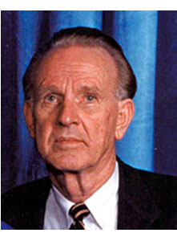
SPUI - HISTORY
The first ever SPUI was designed by Wallace Hawkes for State Route 60 in Clearwater, Florida. The design was completed in 1970, and the interchange opened in 1974.
T. Wallace Hawkes
Google Earth
S.R.60/S.R.19 Interchange
Notes:
Hawkes was Director of Transportation Engineering for J. E. Greiner Company.
Hawkes is known as the “granddaddy of the urban interchange”
- SPUI at S.R.60/S.R.19 has since undergone revisions to add frontage roads.

Slide 6
WHAT MAKES A SPUI A SPUI?
PRIMARY FEATURES…
All left turning movements are controlled by a single traffic signal.
All left turning movements operate to the left of each other, as is typical with “protected-only” left-turn phasing.
The similarities between and SPUI and a traditional diamond increase driver familiarity.
As a result of the reduction in intersection conflict points, the single point urban interchange configuration offers greater capacity than a traditional diamond interchange.
Notes:
- ”Protected Only” left-turn phasing is a common intersection configuration
Most drivers will not notice significant differences when navigating through a SPUI (as compared to CFI and DDI)

Slide 7
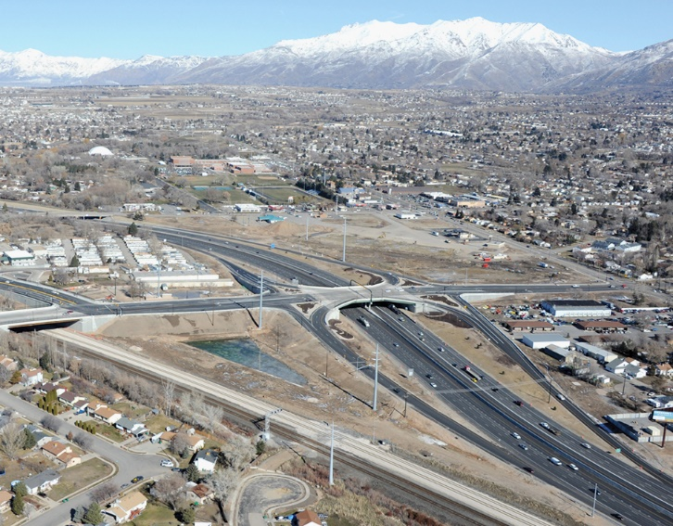
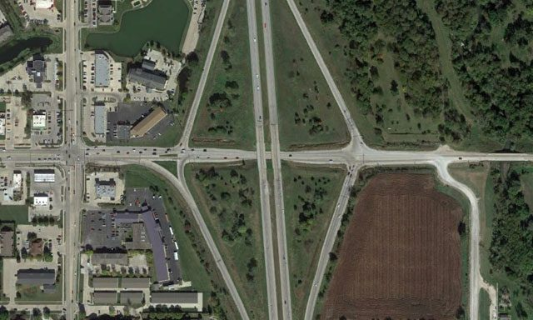
SPUI - ADVANTAGES
REDUCED ROW FOOTPRINT
SPUI configuration generally has a smaller ROW footprint compared to that of a traditional diamond configuration or a cloverleaf configuration.

Slide 8
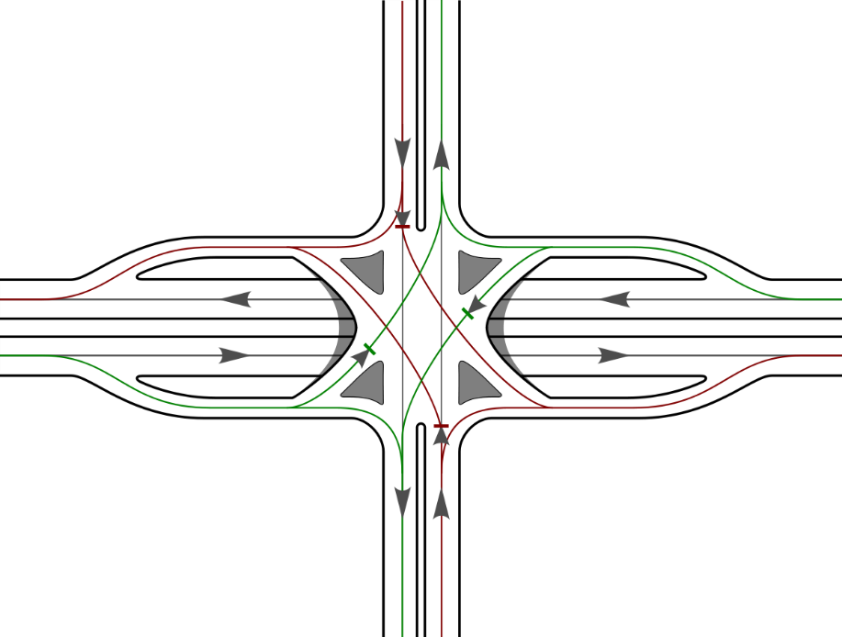
SPUI - ADVANTAGES
INCREASED CAPACITY
The SPUI configuration reduces the conflicts from two points on either side of the interchange to a “single point” in the center of the interchange.
Notes:
- Most SPUIs operate well with only 3 phases.
- In most cases, right turns are separated from the signal and are either yield or free-flowing

Slide 9
SPUI - ADVANTAGES
INCREASED CAPACITY
The SPUI configuration reduces the conflicts from two points on either side of the interchange to a “single point” in the center of the interchange.
Notes:
- Most SPUIs operate well with only 3 phases.
- In most cases, right turns are separated from the signal and are either yield or free-flowing

Slide 10
SPUI - ADVANTAGES
INCREASED CAPACITY
The SPUI configuration reduces the conflicts from two points on either side of the interchange to a “single point” in the center of the interchange.
Notes:
- Most SPUIs operate well with only 3 phases.
- In most cases, right turns are separated from the signal and are either yield or free-flowing

Slide 11
SPUI - DISADVANTAGES
The primary disadvantage to the SPUI is cost. The vast majority of the additional cost of the SPUI configuration is related to the additional square footage of bridge deck needed to accommodate the configuration.

Slide 12
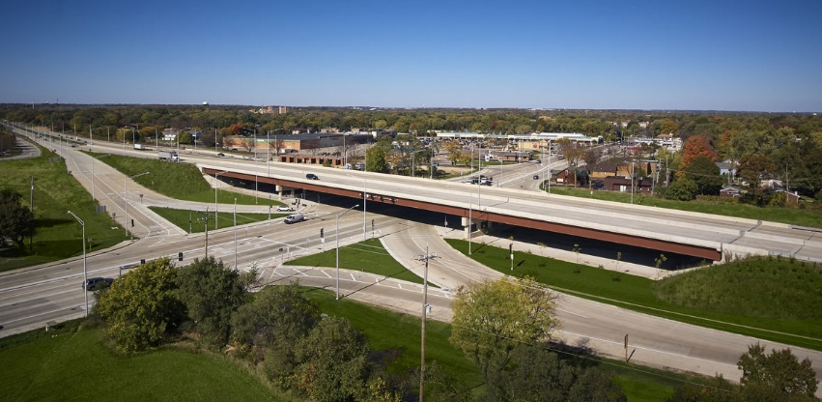
SPUI - DISADVANTAGES
Main lane overpass structures must span the entire intersection, while also
providing adequate sight distance for the left-turn off-ramp movements.
This substantially increases the cost to implement this type of configuration.
Notes:
- Though construction costs are often significantly higher, the reduction to the ROW impacts can sometimes offset the costs, especially in urban areas.

Slide 13
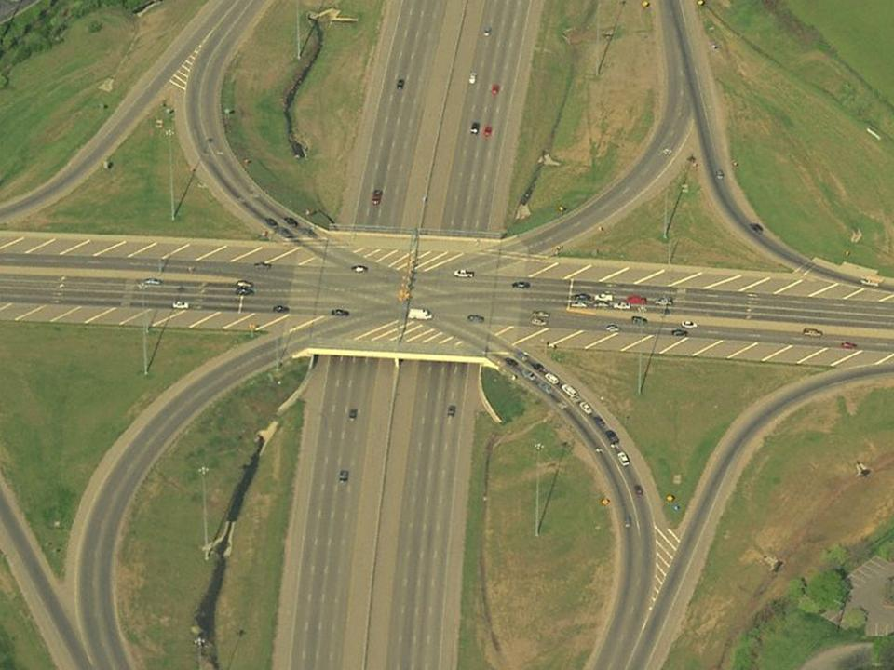
SPUI - DISADVANTAGES
Crossing road overpass structures often result in unused bridge deck area.
Notes:
- Though construction costs are often significantly higher, the reduction to the ROW impacts can sometimes offset the costs, especially in urban areas.

Slide 14
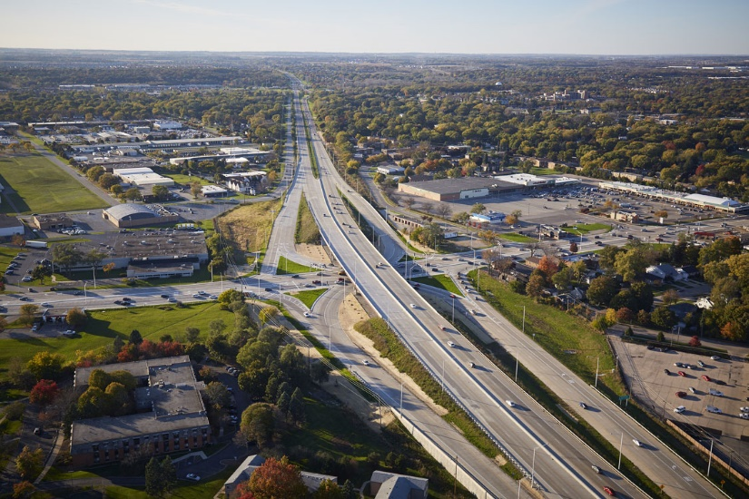
SPUI - DISADVANTAGES
Though construction costs are often significantly higher, the reduction to ROW and
Environmental impacts can sometimes offset the costs, especially in developed urban areas.
Notes:
- Though construction costs are often significantly higher, the reduction to the ROW impacts can sometimes offset the costs, especially in urban areas.

Slide 15
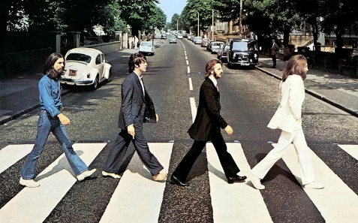
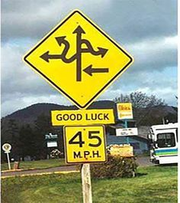
SPUI – DISADVANTAGES
Pedestrians!
Notes:
Allowing pedestrians to cross the arterial is a challangle.

Slide 16
PEDESTRIAN ACCOMMODATION
Ideally, accommodation for pedestrians crossing the arterial should take place at the nearest intersection away from the SPUI. If this is not possible due to high pedestrian traffic at the SPUI location, the two remaining options are either to have an exclusive pedestrian-only phase, or to split the pedestrian crossing into two separate phases. If the pedestrian crossing is split into two phases, a center refuge will be needed within the median of the crossing arterial.
Pedestrian movement parallel to the arterial does not usually present a significant challenge.

Slide 17
SPUIs IN ARKANSAS
While there are pockets of development within the State of Arkansas, the majority of the state consists of sparsely populated rural communities. The majority of the development of the roadway infrastructure within the State of Arkansas pre-dates the recent population growth and economic development of the urbanized areas of the State. As a result, there are no existing Single Point Urban Interchanges currently open to traffic in the State of Arkansas
…YET!

Slide 18
SPUIs IN ARKANSAS
The first SPUI to be let to contract in the state of Arkansas was project BB0903 at the I-49/Highway 71B interchange in the cities of Bentonville and Rogers. The plans for the project were designed by Crafton Tull. The project was let in July of 2018 and is currently under construction.

Slide 19
SPUIs IN ARKANSAS
The second and most recent SPUI to be let to contract in the state of Arkansas was project in CA0903, which will complete the I-49 Bella Vista Bypass. The project was let in July of 2019 and contract execution is pending.

Slide 20
FUTURE SPUIs IN ARKANSAS
Plans are currently being developed for project 061371, which will construct two SPUIs along the US-67 corridor in Cabot. This project is currently scheduled to be let in February of 2021.

Slide 21
Questions???

